Slide 1
Principle of Human Computer Interaction

Slide 2
Introduction to HCI

Slide 3
Outline
Introduction
What is HCI?
  The HCI Challenge
  HCI is Not about
  HCI is about
The goals of HCI
What is Usability?
Why is usability important?
  Why HCI is Important in the Context of WWW?
  It is not Simple to Make Good User Interfaces
Examples of good and bad design

Slide 4
Introduction
Interacting with technology has become an essential part of everyday life for the majority of people.
The average user of a computer system is now less likely to understand the technology. Since, there are different types of technology they have to use.
People are busy and may spend little or no time actually learning a new system.

Slide 5
Introduction..(cont.)
Therefore, computer systems should be easy to use, easy to learn, and with no errors.
To design and develop of such a system is a major concern of HCI

Slide 6
What is HCI?
Human-computer interaction (HCI): “is a discipline concerned with the design, evaluation and implementation of interactive systems for human use and with study of major phenomena surrounding them.”
(ACM SIGCHI, 1992, p. 6)

Slide 7
What is HCI?
HCI (human-computer interaction) is the study of interaction between people (users) and computers.
Interaction between users and computers occurs at the user interface
The golden principle in HCI is that “people should come first”.

Slide 8
What ..(cont.)
HCI consists of three parts:
Human: could be an individual user or a group of users.
Computer: could be any technology ranging from the general desktop computer to a large scale computer system.
Interaction: any direct or indirect communication between a human and computer.

Slide 9
What ..(cont.)
HCI concentrates on the study of human factors
The study of human factors started during the Second World War by US army.
Usability was born because of badly designed arms that caused “friendly fire” during war.

Slide 10
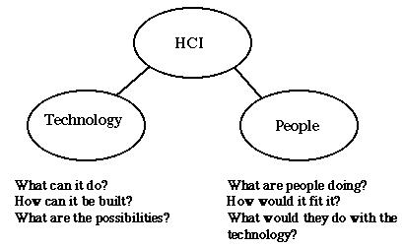
The HCI Challenge

Slide 11
HCI is Not about
Making the interface look pretty
Only about desktop computers (and that goes for computing as well!)
Something that would be nice to do but usually there’s no time for it

Slide 12
HCI is about
Understanding the users
Understanding users tasks
Understanding the surrounding environment
GUI requirements gathering and analysis
Design prototype
Evaluate the system

Slide 13
The goals of HCI
The goal of HCI “is to develop or improve the safety, utility, effectiveness, efficiency and usability of system that include computers.”
(Interacting with computers, 1989, p3)

Slide 14
The goals of HCI
The goals of HCI are to produce usable and safe systems, as well as functional systems. In order to fulfill that, developers must attempt to:
  Understand how people use technology
  Building suitable systems
  Achieve efficient, effective, and safe interaction
  Put people first
  People needs, capabilities and preferences should come first. People should not have to change the way that they use a system. Instead, the system should be designed to match their requirements

Slide 15
What is Usability?
A usable system is:
  easy to use
  easy to learn
  easy to remember how to use
  effective to use
  efficient to use
  safe to use
  enjoyable to use

Slide 16
Why is usability important?
A Good user-interface can:
1. Earn a company billions.
2. Increase users loyalty.
3. Increase users trust.
4. Makes users happy : )

Slide 17
Why ..(cont.)
A Bad user-interface can:
1. be annoying, embarrassing, frustrating, and even deadly.
2. Increase mistakes in data entry and system operation.
3. Makes functions become completely inaccessible.
4. System failure because of user rejection.

Slide 18
Why HCI is Important in the Context of WWW?
• Competition is very close (just another link…)
• Comparison is easily possible (example – Online-Shop)
• Users who can’t find the product in the shop can not buy it
• Users who are not able to fill in correctly the order form are not going to buy

Slide 19
It is not Simple to Make Good
User Interfaces
Basic misconceptions:
• If I (the developer) can use it, everyone can use it
• If our non-technical staff can use it, everyone can
• Good user interfaces are applied common sense
• A system is usable if all style guidelines are met

Slide 20
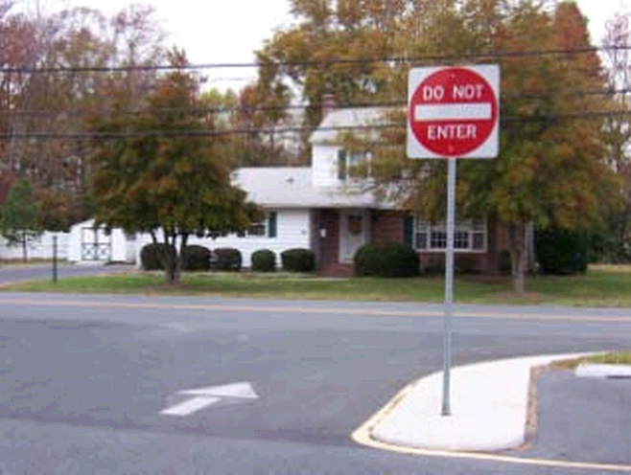
Examples of good and bad design

Slide 21
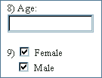
Examples ..(cont.)

Slide 22
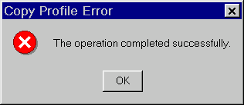
Examples ..(cont.)

Slide 23
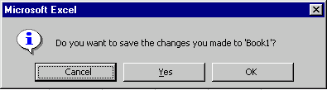
Examples ..(cont.)

Slide 24
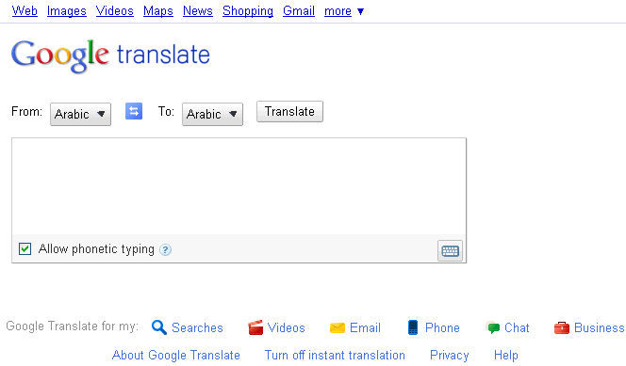
Examples ..(cont.)

Slide 25
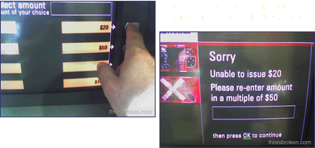
Examples ..(cont.)

Slide 26
References
http://www.cs.bham.ac.uk/~rxb/Teaching/HCI%20II/intro.html
http://www.baddesigns.com/examples.html
http://www.goodexperience.com/tib/archives/webtech/
http://pages.cpsc.ucalgary.ca/~saul/hci_topics/topics/psych.html
http://homepage.mac.com/bradster/iarchitect/
www.useit.com
http://faculty.ed.umuc.edu/~meinkej/inss690/wilson.htm

